Slide 1
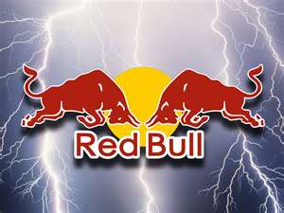
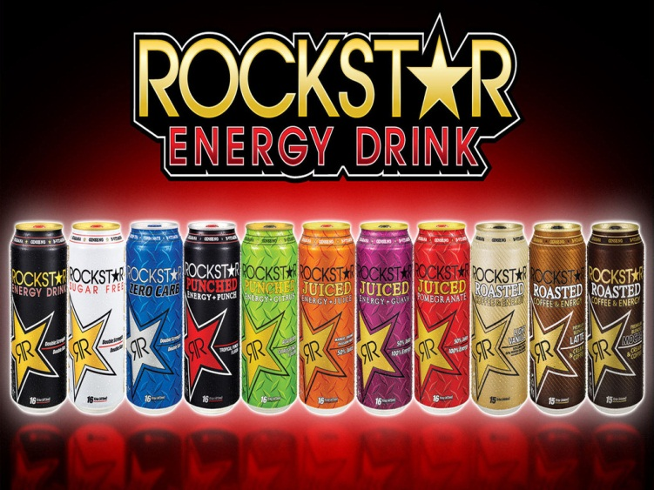
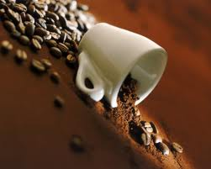
The Heart attack

Slide 2
Problem/Question
Will different caffeinated drinks raise heart rates at varying rates?

Slide 3
Hypothesis
The hypothesis was that caffeinated drinks will raise the heart rate. Two subjects tested their resting heart rates before the experiment, then drank a caffeinated drink and tested their heart rate every five minutes. This experiment was repeated with different types of caffeinated drinks, such as Red Bull, Rockstar, and coffee. The results demonstrated that the energy drinks Red Bull and Rockstar raised the heart rate more significantly than coffee. This is probably related to the fact that energy drinks have twice the amount of caffeine than coffee.

Slide 4
Materials and methods
Rockstar 8 oz (80 mg caffeine per serving)
Red Bull 8.4 oz (80 mg caffeine per serving)
Coffee (4 scoops in 8 oz water) (100 mg caffeine per serving)
Timer
Heart Rate Monitors
Paper and Pencil to Document Results
1.Gathered materials and cleared a workspace. Subjects had not eaten any solid food for four hours prior to the experiment. Subjects tested their body mass index, which was 19.4 and 20 receptively.
2.Tested resting heart rates while lying on the floor after waiting 5 minutes.
3.Subjects drank Red Bull in a total elapsed time of 4 minutes.
4.Subjects laid down again, and rechecked resting heart rates at 5 minute intervals (with results recorded) for a duration of 1 hour.
5.The experiment was repeated with Rockstar and coffee (steps 1-4) on the next 2 consecutive days. This was repeated at the same time each day.

Slide 5
Procedure
Buy Redbull, Rockstar, and Coffee
Gather materials and clear a work space
Next while laying on the floor for five minutes test your resting heart rates with a heart rate monitor
Consume the Redbull in four minutes
After that lay back down and check your heart rate every five minutes over a span of 1 hour
Record your results and make a line graph showing how your heart rate changed
Wait a day between drinks
Then repeat steps one through five with Rockstar and coffee

Slide 6
Conclusion
This experiment was designed to figure out which caffeinated drinks affect heart rate, and how much. Our hypothesis was proven correct in that the energy drinks increased heart rate by 10-20 heart beats per minute consistent with the fact that they have a large amount of caffeine. However, coffee, a substance that has even more caffeine than the energy drinks, did not change the subjects’ heart rate at all. In fact, the subjects’ heart rates decreased when drinking the coffee.
This could be accounted for by the fact the energy drinks had sugar, and the coffee did not. But we are not aware of sugar increasing the heart rate. This could be explained because the subjects thought that prior to the experiment, the energy drinks had more caffeine than the coffee and would therefore raise the heart rate more.
It is very puzzling to explain why the caffeine in the coffee did not raise the heart rate significantly. In energy drinks, the caffeine is in a very purified form, whereas in coffee, the caffeine is part of the coffee bean. Could that be the reason? In addition, there are multiple chemical ingredients in the energy drinks that are not found in coffee. They may also affect heart rate. The way to sort this out is to first to repeat the experiment and see if it is reproducible. The next step would be to study the effects of purified caffeine.

Slide 7
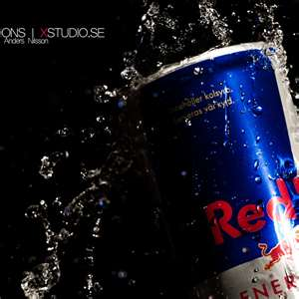
RedBull
Facts-
-Sold in 100 countries worldwide but, only France and Denmark have banned it.
-Most popular energy drink in the world, 3 billion cans sold a year.
Nutritional facts-
1 Serving Per container
250 ml serving
27 grams of sugar
1000 mg of taurine
600 mg of glucuronalctone
80 mg of caffeine

Slide 8
Redbull heart rates

Slide 9
Pictures
http://www.bing.com/images/search?q=redbull+images&view=detail&id=F58A830D83F8353B1FD521851DA896D87562A75D&first=30&FORM=IDFRIR
http://www.bing.com/images/search?q=redbull+images&view=detail&id=F58A830D83F8353B1FD521851DA896D87562A75D&first=30&FORM=IDFRIR
Resources

Slide 10
N
Nutritional Facts-
8.0 fl oz
2 Servings per container
31g of sugar
24mg of sodium
1000mg of taurine
150mg of Ginkgo Binoba Leaf Extract
80mg of Caffeine
25mg of Guarana Seed
Extract
25mg of Inositol
25mg of L-Carnitine
25mg of Panax Ginseng Extract
20mg of Milk Thistle Extract
Calories

Slide 11
Rockstar Heart rates

Slide 12
R
E
S
O
U
R
C
E
S
R
E
S
O
U
R
C
E
S
Pictures
http://www.bing.com/images/search?q=rockstar+energy+drink+&view=detail&id=6FF5D13B8EAE0038AB8C05ED0EC2B172F203BB1D&first=0&FORM=IDFRIR
http://www.bing.com/images/search?q=rockstar+energy+drink+&view=detail&id=6FF5D13B8EAE0038AB8C05ED0EC2B172F203BB1D&first=0&FORM=IDFRIR

Slide 13
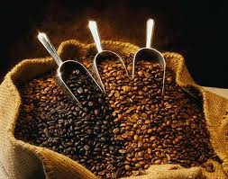
Coffee
Nutritional Facts
2 calories
0g of saturated fat
0g of trans fat
0mg of cholesterol
5mg of sodium
0g of dietary fibers
0g of sugar
200mg of caffeine

Slide 14
Coffee Heart rates

Slide 15
Picture Resources
http://images.google.com/search?tbm=isch&hl=en&source=hp&biw=1311&bih=588&q=coffee&gbv=2&oq=coffee&aq=f&aqi=g10&aql=&gs_sm=e&gs_upl=907l2416l0l2830l6l6l0l1l1l0l312l1289l0.1.3.1l5l0
http://images.google.com/search?tbm=isch&hl=en&source=hp&biw=1311&bih=588&q=coffee&gbv=2&oq=coffee&aq=f&aqi=g10&aql=&gs_sm=e&gs_upl=907l2416l0l2830l6l6l0l1l1l0l312l1289l0.1.3.1l5l0
http://images.google.com/search?tbm=isch&hl=en&source=hp&biw=1311&bih=588&q=coffee&gbv=2&oq=coffee&aq=f&aqi=g10&aql=&gs_sm=e&gs_upl=907l2416l0l2830l6l6l0l1l1l0l312l1289l0.1.3.1l5l0

Slide 16
By: Ranier Ford and Avra Saslow

